Slide 1
Fraud - RED FLAGS
As Maine Bankers, we feel it is our collective responsibility to protect our customers. One way we can do that is to educate our communities on common fraud red flags. As a result, we have collaborated on this presentation and are working together to get this message out in ALL our communities. Maine Banks are united in protecting customers from fraudulent activity.

Slide 2
Introductions
Name
Name
Title
Title

Slide 3
Lottery Winner
Phone call/email stating that you WON a lottery!
You just need to send money for taxes or delivery fees.
The scammer may call multiple times to gain your trust and convince you that you WON!
Legitimate lotteries do not require up front payments – this is ALWAYS a SCAM!
Slide 1

Slide 4
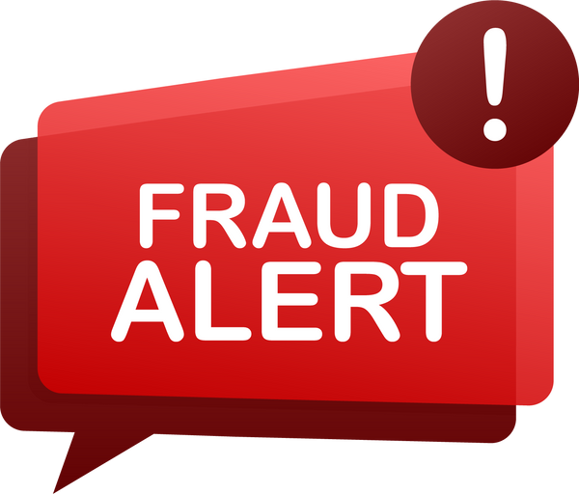
You’re selling something online and the buyer sends extra funds…
Selling an item online and a buyer contacts you to purchase it.
They send you funds to cover the item, plus extra. They may say this was an error, or to cover additional costs such as shipping.
All you need to do is deposit the check and send back the additional funds!
Legitimate buyers will never send extra funds by mistake. Be cautious when selling items online. Scams are very common!
Slide 2

Slide 5
Payment Required via Gift Card
You are contacted by someone requesting payment!
This could seem like a legitimate agency, such as state tax payments, the IRS, or businesses like Amazon or Apple.
The caller or emailer will spend time trying to convince you that you owe money, including trying to scare you into paying as quickly as possible.
Payment will be requested by gift card AND they will ask you to read them the gift card numbers over the phone. Legitimate agencies or companies will NEVER request payment in this manner. This is ALWAYS a scam!
Slide 3

Slide 6
Mailing Cash Inside a Magazine
Has someone asked you to mail cash in between magazine pages or rolled up in a towel?
This may be asked of you because the person doesn’t have access to a bank account, or as a method of payment.
Cash should NEVER be sent through the mail. This is a common method used during a scam!
Slide 4

Slide 7
Wiring Funds to People You Don't Know
You are asked to wire funds to someone who you don’t know, or you haven’t met in person.
You may be told the person doesn’t have a bank account, or that you are wiring funds to their friend.
You may even be asked to lie to the bank about why or who you are sending the funds to!
Wired funds cannot be retrieved once sent. Use caution whenever wiring funds, and never wire funds to someone you don’t know!
Slide 5

Slide 8
Cryptocurrency as Payment
You are asked to send payment for a service or for money owed via Cryptocurrency.
Common crypto companies are Coinbase, Cash App or BitcoinCash.
The individual may pressure you or scare you into paying them this way.
Legitimate agencies or companies will NEVER request payment in this manner. This is ALWAYS a scam!
Slide 6

Slide 9
You receive a deposit and are instructed to send it out right away…
Someone you are in contact with says they are sending you money!
This could be a wire deposit, an electronic payment or any other means of payment.
All you need to do is immediately withdraw the funds once received and send them back!
Do not move money for other people. The funds being sent are often stolen or fraudulent. This is ALWAYS a scam!
Slide 7

Slide 10
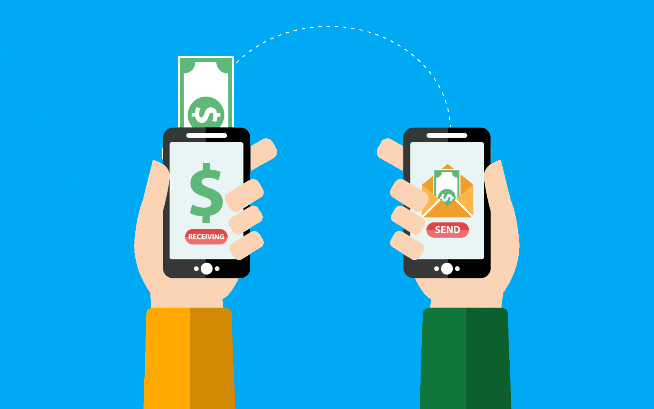
Money Can Move Quickly
Peer-to-Peer (P2P) Payment apps allow funds to move from one person to another quickly.
P2P apps include, Venmo, PayPal and Cash App. Zelle is also a P2P application.
These apps are often used by fraudsters, and you may be asked to send money using them.
If you use these apps, ONLY use them with people you know and trust!
Slide 8

Slide 11
The Common Red Flags
Unexpected phone calls, emails or text messages with links to click.
Being asked for access to your computer, account number, ID information, or online banking information.
Receiving payments for a different amount than what you were expecting, or from a different source.
Being asked to quickly return funds that were sent to you.
Slide 9

Slide 12
Contact Us.
Contact Us.
Do not wait!
Whichever Maine Bank you use – we are here to help you.
Contact us and we will support you through the situation.
Address : 2 Thomas Drive
Westbrook, ME 04092
Phone : (207) 791-8400
Fax: (207) 774-5693
Website : https://www.mainebankers.com/

